Slide 1
EMPLOYEE DATA ANALYSIS USING EXCEL
STUDENT NAME: D.ABIRAMI
REGISTER NO: 312216360
DEPARTMENT: III.B.COM.(Computer application)
COLLEGE: SHRI SHANKARLAL SUNDARBAI SHASUN JAIN COLLEGE FOR WOMEN

Slide 2
Project title:
EMPLOYEE PERFORMANC ANALYSIS USING EXCEL

Slide 3
AGENDA:
Problem statement
project overview
End users
Our solution and proposition
Dataset description
Modelling approach
Result and discussion
Conclusion

Slide 4
Problem statement:
Data Collection: Gather relevant data on employee performance, including sales targets, actual sales, customer satisfaction ratings, attendance and punctuality records.
Sales Performance Analysis: Identify employees struggling to meet sales targets and analysis trends, in sales performance.
Top Performers: Determine the top 3 sales performers based on actual sales achieved VS targets.
Recommendations: Offer recommendations for training and development programs to improve overall sales performance based on the analysis.

Slide 5
Project overview:
Analysis Employee Sales Performance: Evaluate employee performance using excel to identify the top performers, areas for improvement, and trends in sales data.
Data Driven Insights: Provide actionable recommendations for training, growth, and improvement based on the data analysis and visualization.
Drive Business Growth: Enhance business growth by making data driven decisions, improving employee performance, and optimizing sales strategies.
Improved Decisions Making: Enhance HR and management teams decisions making capabilities with accurate and timely employee performance data, driving business growth and improvement.

Slide 6
End users:
HR Managers: Use data analysis to identify training needs, evaluate employee performance and make informed decisions.
Sales Managers: Analysis sales trends identify top performers and optimize sales strategies to drive business growth.
Team Leaders: Use data driven insights to coach and develop team members, improving overall team performance.
Executives: Make strategic decisions based on the data analysis driving business growth and improving overall employee performance.

Slide 7
solution and proposition:
Comprehensive Analysis: Our excel based solutions provides a 360 degree view of employee performance, covering sales, customer satisfaction, and attendance metrics.
Data Driven Insights: We help you uncover hidden trends and patterns in your data, enabling informed decisions on training, coaching, and performance improvement.
Customizable Dashboard: Our solutions offers tailored dashboard to meet your specific needs, ensuring seamless integration with your existing HR systems and processes.
Actionable Recommendations: We provide concrete, data backed suggestions for improving employee performance, driving business growth, and enhancing overall organizational effectiveness.

Slide 8
Dataset description:
Sales Data: Includes actual sales, sales targets, and sales achievement percentages to evaluate employee performance.
Employee Data: Encompasses employee information, such it as name, id, department, and job title to provide context for performance analysis.
Performance Metrics: Covers key performance indicators (KPIS) like customer satisfaction ratings attendance records and punctuality metrics.
Time Stamped Data: Includes historical data with timestamps to track employee performance trends, progress, and regression overtime.

Slide 9
The “wow” in our solution:
track and analyze employee performance metrics
Identify top performers and areas for improvement with ease
Make data driven decisions to boost productivity and engagement
Scale and adapt to evolving business needs with flexibility and ease.

Slide 10
Modelling approach:
Descriptive analytics: use excel formulas and functions to analyze and describe employee performance data, identifying trends and patterns.
Predictive analytics: employ excels statistical and data modeling tools to forecast future employee performance and identify potential improvement areas.
Prescriptive analytics: develop actionable recommendations using excels optimization and scenario planning tools to drive employee performance improvement.
Data visualization: utilize excels data visualization capabilities to create interactive and dynamic dashboards, facilitating clear communication of insights and recommendations.

Slide 11
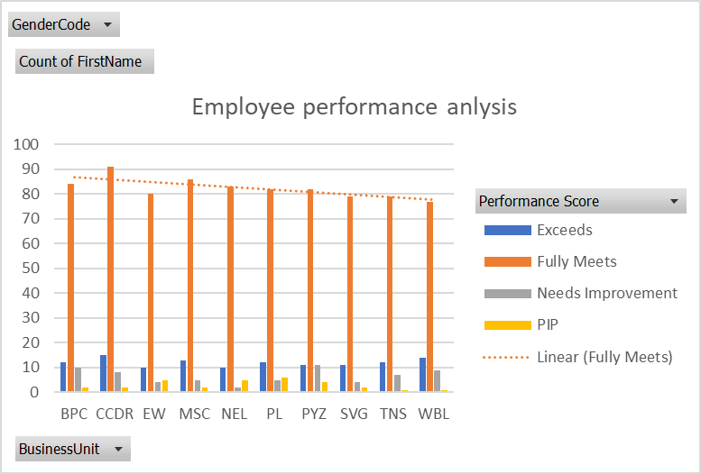
results:

Slide 12
Conclusion:
By harnessing the power of excel for employee performance analysis, organizations can unlock the full potential of their workforce, drive business growth, and make data driven decisions to boost productivity and engagement, identify and develop top performers, improve training and development programs, and enhance overall workforce management.

